Slide 1
Second Submission (2-A)
Document Classifier
Group Members :
Amritansh Tripathi 2011186
Nitish Bhagat 2011204
Piyush Agarwal 2011206
Piyush Raman 2011257

Slide 2
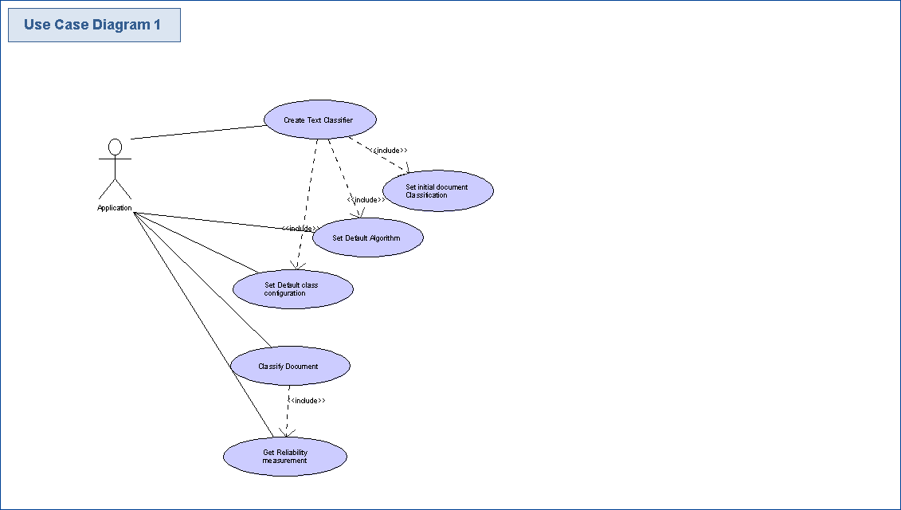
Use Case Diagram

Slide 3
Use Case Documentation

Slide 4
Use Case Name : | CreateTextClassifier
Participating Actors : | Application
Flow of Events : | Application using Software components creates instance of Text Classifier Class . If initially algorithm and Class Configuration are not provided then use step (3) and step (4) else use step (5) . Instance created uses set Default Algorithm (Naïve – Bayes Algorithm) use case. Instance created uses set Default Class Configuration use case. Instance uses set Initial Document Classification use case.
Entry Condition : | Application having a copy of Software Components needs to classify document.
Exit Condition : | Application gets the classes associated with documents.

Slide 5
Use Case Name : | SetDefaultAlgorithm
Participating Actors : | Application , Text Classifier Object
Flow of Events : | Text Classifier uses configManager to get the string associated with default class of algorithm to be used . ClassLoader loads the class of Default Algorithm with string name . Text Classifier creates the instance of Default Algorithm Class .
Entry Condition : | Either External Application initiates to set Default Algorithm or Text Classifier Object use this to set initial algorithm .
Exit Condition : | Actor receive the instance of default initial algorithm .

Slide 6
Use Case Name : | SetDefaultClassConfiguration
Participating Actors : | Application , Text Classifier Instance
Flow of Events : | Text Classifier provides algorithm name to configManager . ConfigManager sets Default Class Configuration associated with algorithm.
Entry Condition : | Either External Application initiates to set Default Class Configuration or Text Classifier Object initiates this use case.
Exit Condition : | Default Class Configuration is set .

Slide 7
Use Case Name : | ClassifyDocument
Participating Actors : | Application
Flow of Events : | Application provides document and classification algorithm. Text Classifier classifies the document according to classification algorithm. Classification Algorithm returns document class to text classifier instance. Text Classifier instance returns document class to Application.
Entry Condition : | External Application provides document to document class classifier .
Exit Condition : | Application receives document class.

Slide 8
Use Case Name : | GetReliabilityMeasurement
Participating Actors : | Application
Flow of Events : | Application provides document , document class and classification algorithm. Text Classifier provides document and document class to classification algorithm. Classification Algorithm returns reliability measure to text classifier instance. Text Classifier instance returns reliability measure to Application.
Entry Condition : | External Application provides document to reliability measure classifier .
Exit Condition : | Application receives reliability measure.

Slide 9
Sequence Diagrams (2-B)

Slide 10
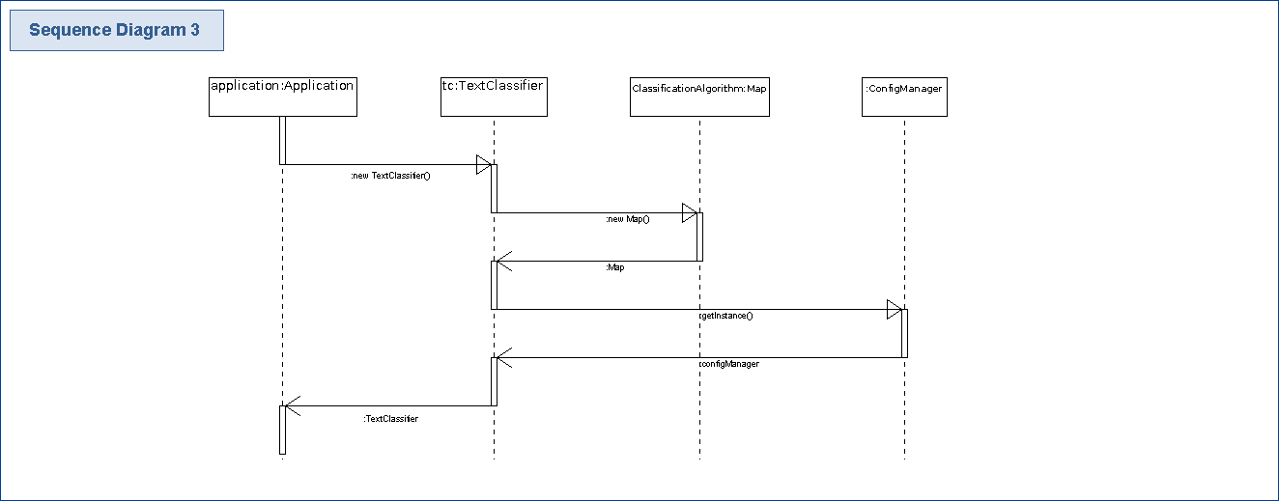
Create Text Classifier Sequence Diagram

Slide 11
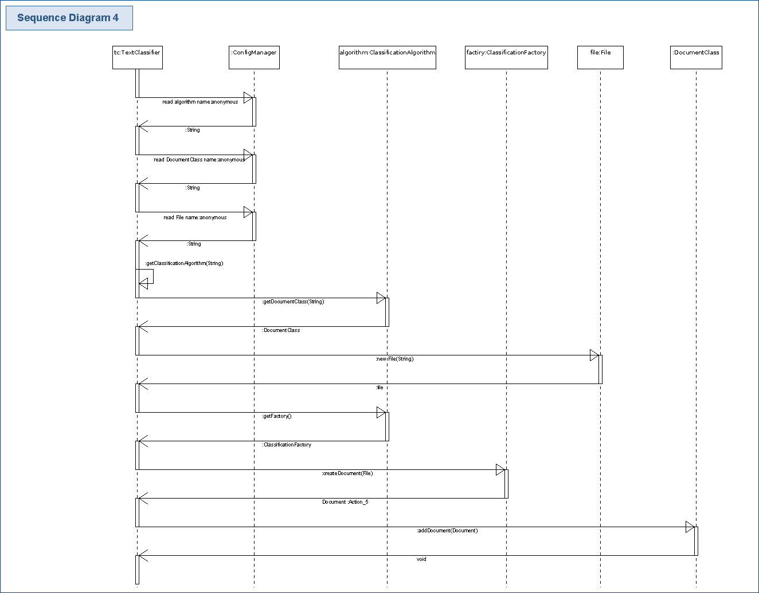
Set Initial Document Classification Sequence Diagram

Slide 12
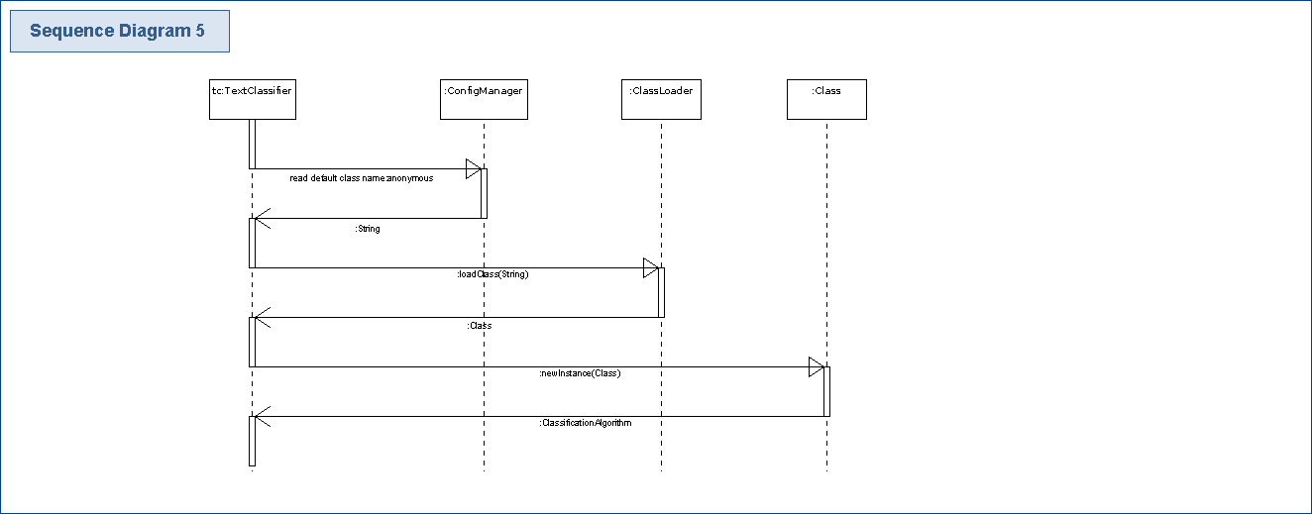
Set Default Algorithm Sequence Diagram

Slide 13
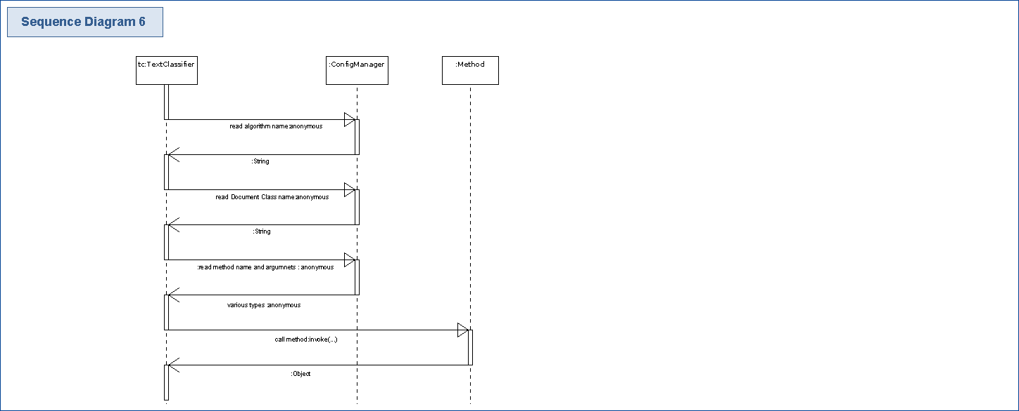
Set Default Class Configuration Sequence Diagram

Slide 14
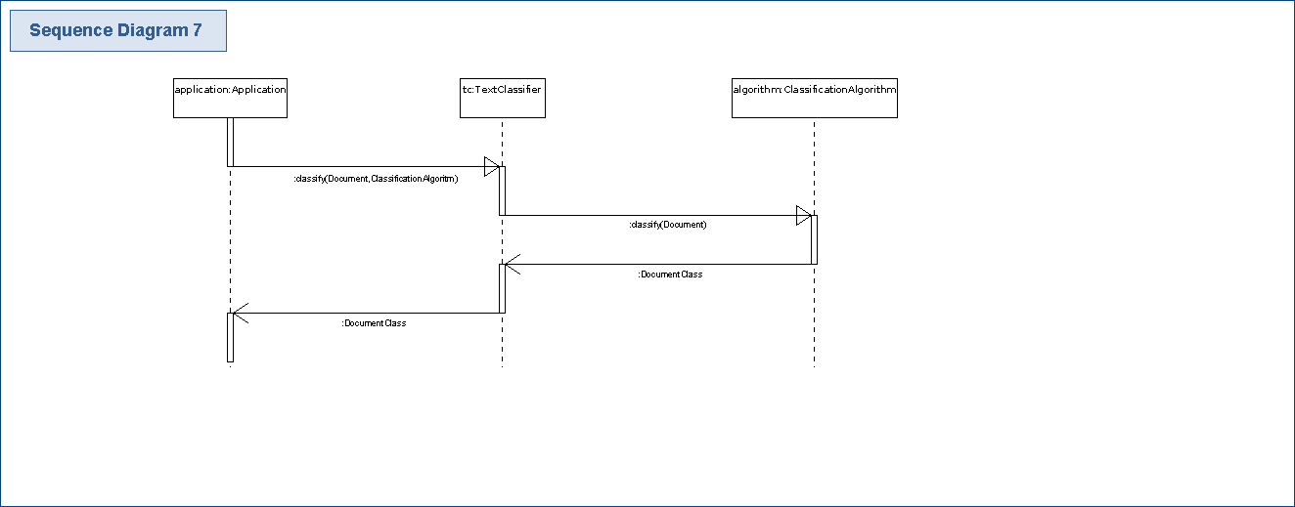
Classify Document Sequence Diagram

Slide 15
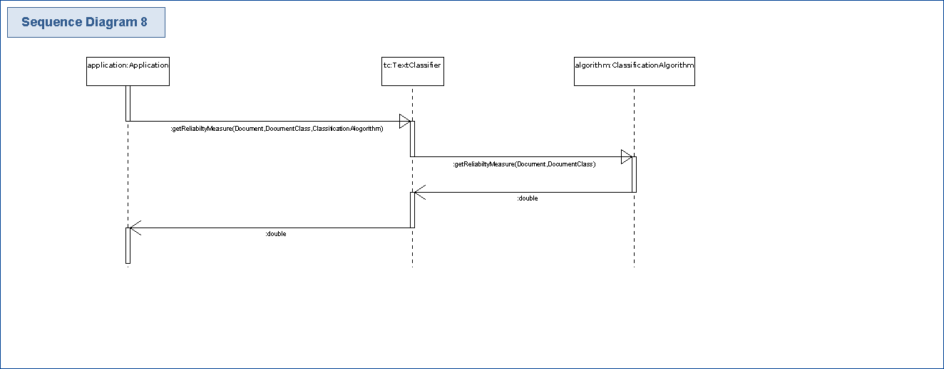
Get Reliability Measurement Sequence Diagram

Slide 16
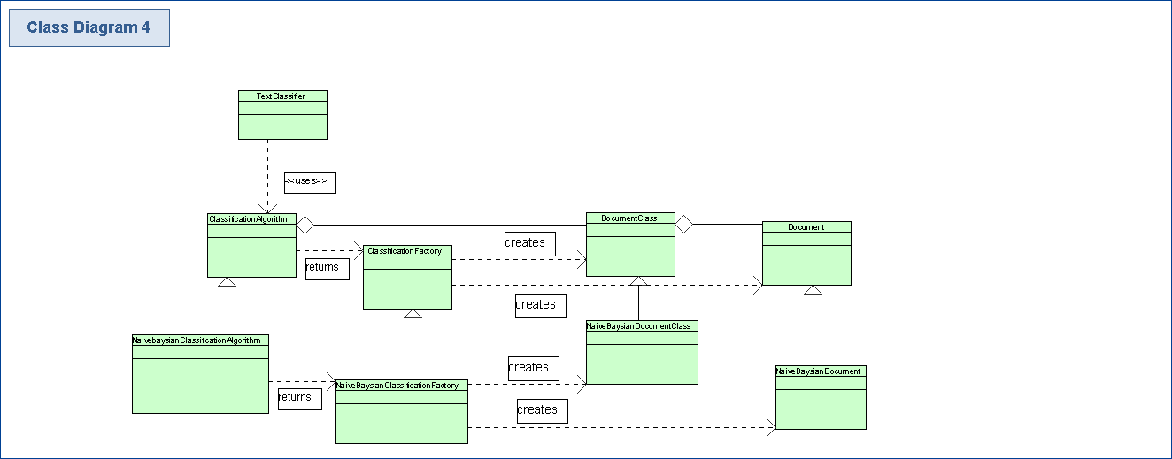
Class Diagram

